Slide 1

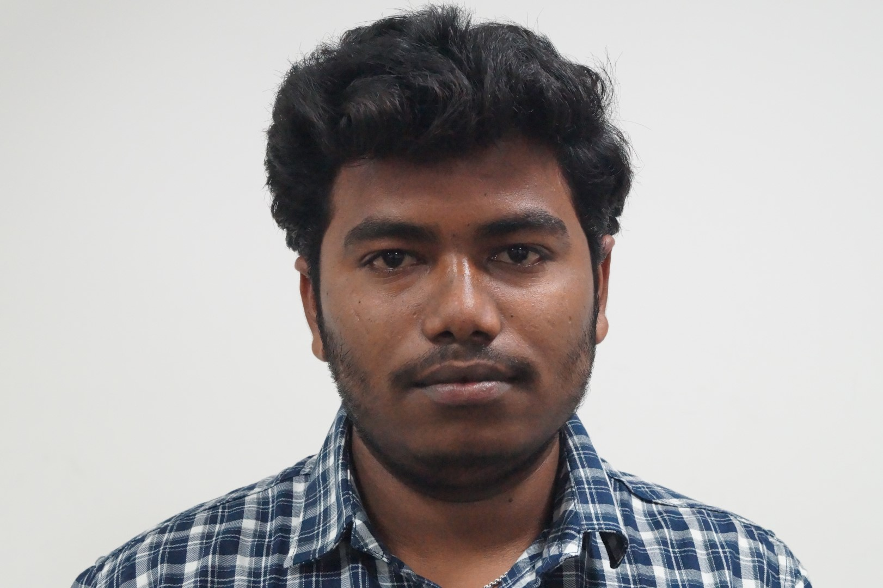
Student Profile
NAME: D.Gopi Krishna
REGISTRATION NUMBER: 192011065
COURSE CODE: CSA4352
COURSE NAME: Internet programming
With web design
PROJECT TITLE: ONLINE BLOOD BANK MANAGEMENT SYSTEM
PHOTO

Slide 2
Abstract: The Online Blood Donation Management System, the purpose of which is to act as a bridge between a person who needs blood, a patient, and a blood donor. The design of an automatic blood system has become an integral part for saving the human lives, who need the blood under different situations. Since, there are various drawbacks of the pre-existing system like privacy issues for the donors, which are getting reflected directly on the interface. Thus, we have designed a robust system that will create a connection between different hospitals, NGOs, and blood banks to help the patient in any difficult situation. Thus, HIPPA model provides a backbone for security breaches The interface designed will be easy-to-use and easy to access and will be a fast, efficient, and reliable way to get lifesaving blood, totally free of chart.
INTRODUCTION: Since blood cannot be stored for an indefinite amount of time, a constant source of blood donation is required to the WHO, the sustainable approach toward ensuring prompt and effective access to the sources of safe blood and blood products is to develop a nationwide. organized blood transfusion program focused on voluntary non remunerated blood donors (VNRBD) . Recruiting voluntary blood donors remains one of the significant challenges for any blood transfusion service. Out of 193 WHO Member States, only 62 countries (32%) reported receiving more than 99% of their blood supply through VNRBD . In general, blood banks face multifaceted challenges in resource limited conditions like rural areas of Bangladesh. Blood storage is a big concern due to the unavailability of continuous electricity supply in many parts of Bangladesh and other parts of the world.
MODULES:
USER:There are two type of user in this project donor and customer. Donor can register to the web site by giving his personal details like name, blood group, address, contact details etc. Once registration is done he can post his donation. Customer can register to the portal and view list of donors who are interested to donate blood. He can also search list of donors based on the blood group. Once he gets suitable donor he can directly contact the donor.
ADMIN: Admin is responsible to post all the information related to blood donation. Admin can view list of voluntary blood donors and help the needy by providing their information to blood bank and patients. Admin can send a blood request to other blood bank in case of emergency or shortage of blood.

Slide 3
Working principles:
Donor facility:
1. A donor can register himself as a donor
2. Adding his ability of donating the blood
3. Can see the request for blood
User facility:
1. Can see all the donors and blood bank
2. Can filter donor and blood bank according to the blood group and city
3. Sending the request for the blood to donor and blood bank
Admin facilities:
1. Can see donors
2. Update, delete and verify donor
Manager facilities:
1. Manage Blood Bank

Slide 4
Output:
The blood bank management system is created with a functionality of requesting for an certain blood group for and getting the connection when they get a donor.
Conclusion:
The blood management system has been experimentally proven to work satisfactorily by
developing web applications and the system can be by donor and user etc
We learned many skills such as database modelling, other web tools that we use for this
project and being able to work together as a team during this project
Future upgradation:
Upgrading a panel for the donors to stay updated.

